Slide 1


CSS (Cascade Style Sheets)

Slide 2
What Is CSS?
CSS stands for Cascading Style Sheets
CSS is a language used to define the layout and appearance of webpages.
CSS was first developed in 1997
External stylesheets are stored in CSS files.

Slide 3

CSS-Syntax
A CSS syntax consists of a selector and a declaration block.
HTML Code
CSS Code
Selector
<body>
<h1>Job Provider</h1>
</body>
h1
{
color : blue;
}
Value
Property
Declaration block

Slide 4


Inline CSS
For apply CSS in a single element .
The inline CSS is also a method to insert style sheets in HTML document.
To use inline CSS, should use the style attribute to the relevant tag.
<body>
<h2 style="color:red;margin-left:40px;“ >Job Provider</h2>
</body>

Slide 5

Internal CSS
The internal style sheet is used to add a unique style for a single document.
It is defined in <head> section of the HTML page inside the <style> tag.
<head>
<style>
h2 { color:blue;}
</style>
</head>
<body>
<h2>Job Provider</h2>
</body>

Slide 6

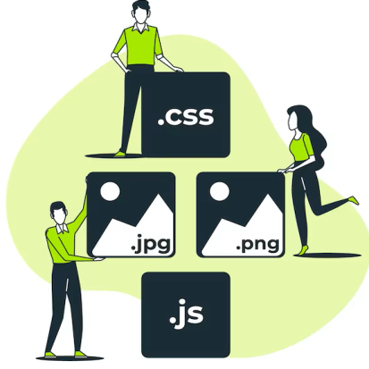
External CSS
The external style sheet is generally used to make changes on multiple pages.
It uses the <link> tag on every html pages and the <link> tag should be put inside the head section.
An external style sheet can be written in any text editor, and must be saved with a .css extension.
<body>
<h2>Job Provider</h2>
</body>
jobProvider.html
h2
{
color:blue;
}
styles.css

Slide 7


Slide 8
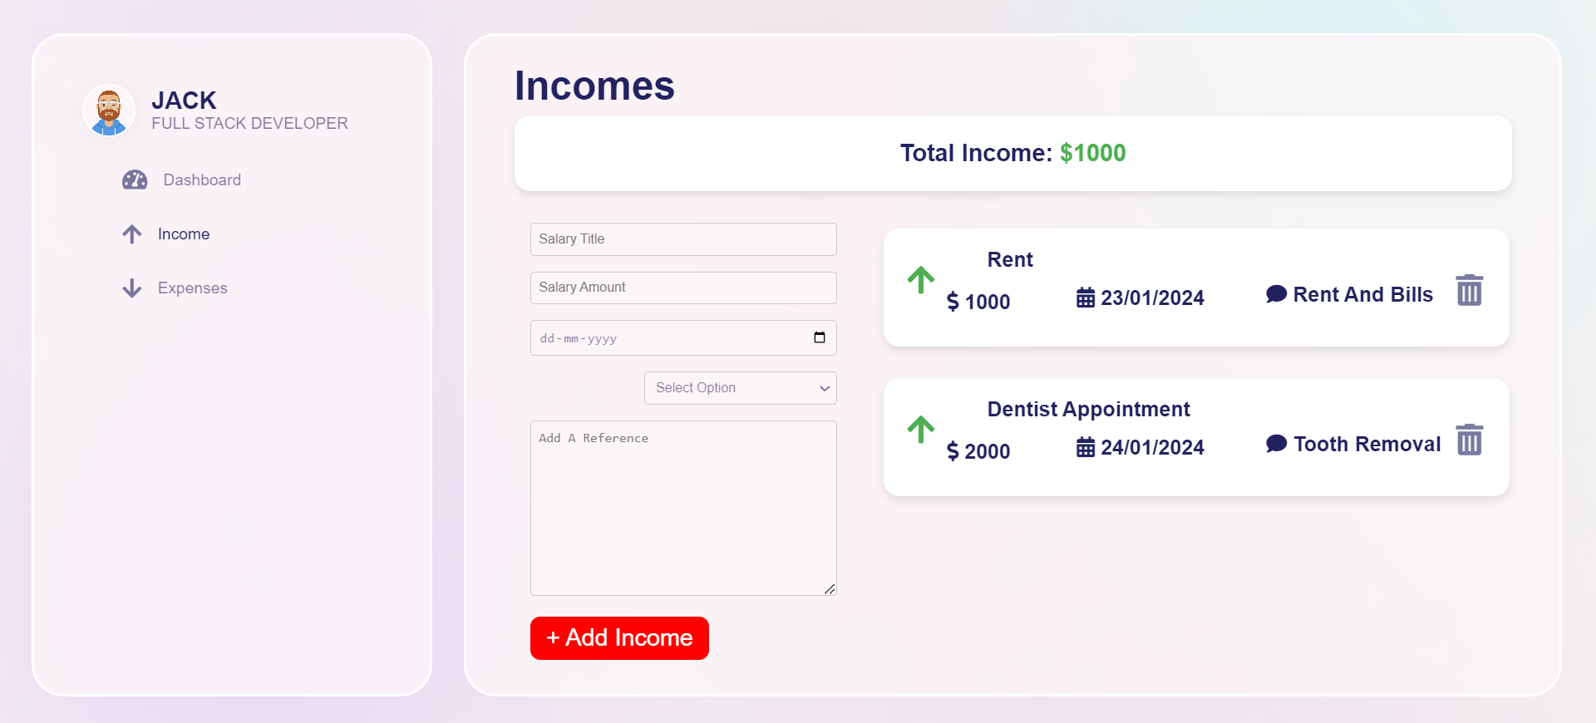

Slide 9
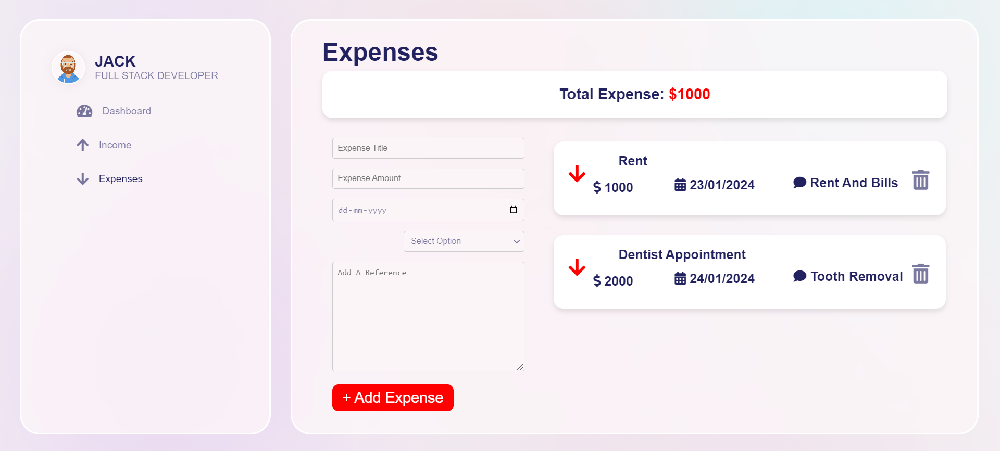

Slide 10

CSS-Styling Background
Properties | Description
background-color | Specifies the background color to be used
Background-image | Specifies ONE or MORE background images to be used
Background-attachment | Specifies whether the background images are fixed or scrolls with the rest of the page
Background-position | Specifies the position of the background images
Background-size | Specifies the size of the background images
Background-repeat | Specifies how to repeat the background images
Background-origin | Specifies the positioning area of the background images
Background-clip | Specifies the painting area of the background images
CSS-Font Properties
font-family
To change the typeface of your text .
font-style
To set whether text should be italic or not.
font-weight
To set the boldness of text.
font-size
To control the size of your text elements.

Slide 11

CSS-Text Properties
Word-spacing
To increase or decrease the length of space between each word in your text
Text-indent
To add an indent to your blocks of text.
color
To set the color of the text.
Background-color
To set the color of background.

Slide 12

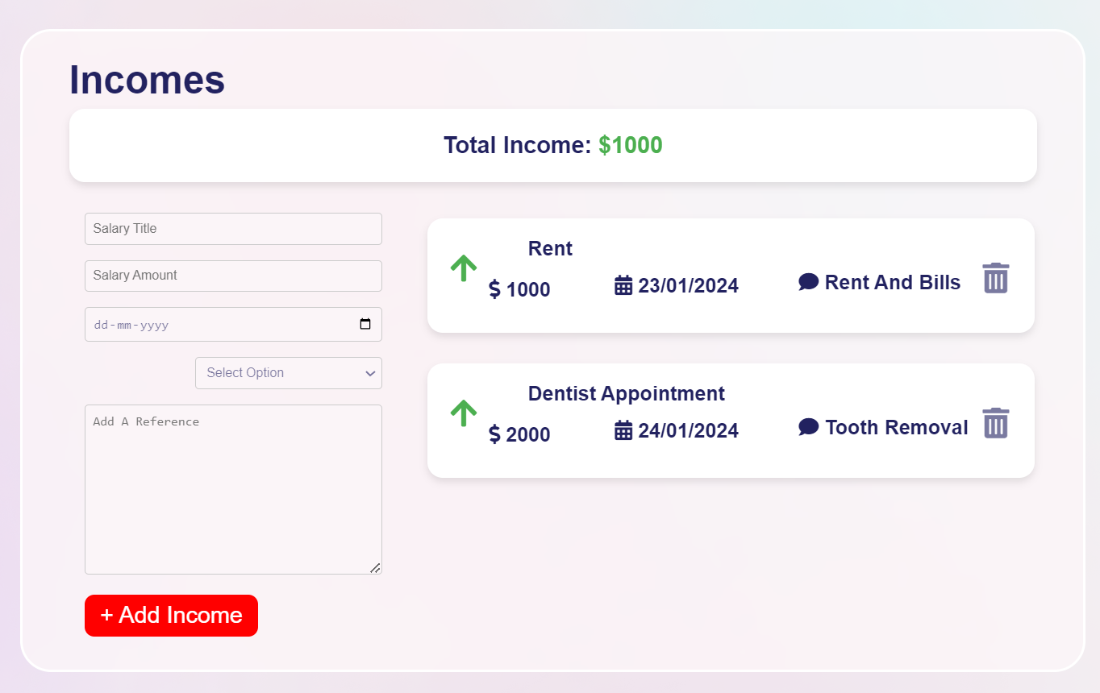
Border
The border property is a shorthand syntax in CSS that accepts multiple values for drawing a line around the element it is applied to.
Values
Border-width
Border-style
Border-color

Slide 13
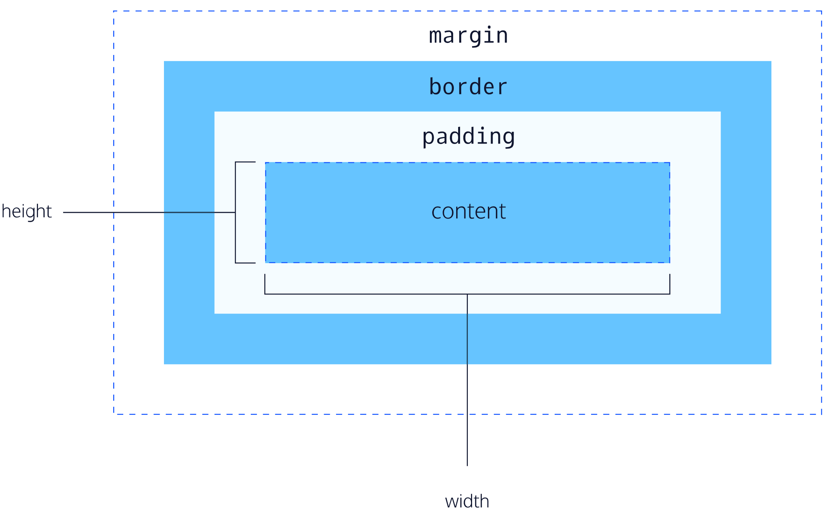
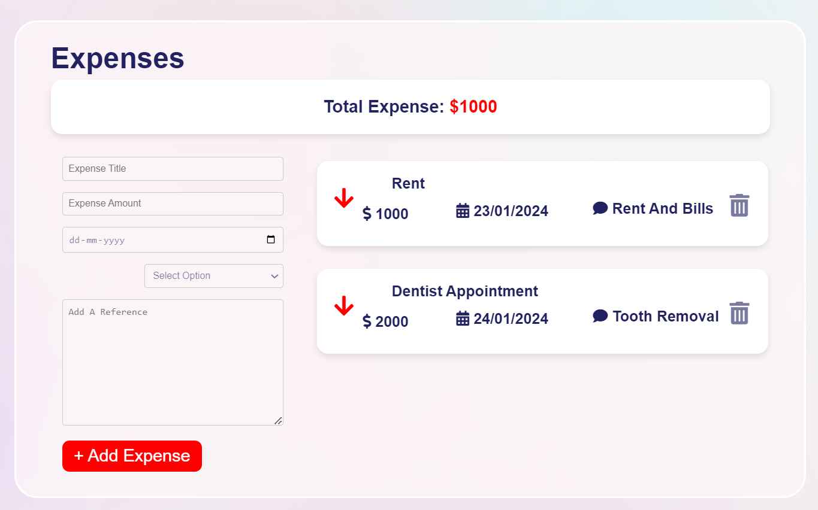
Box Model
A CSS box model is a compartment that includes numerous assets, such as edge, border, padding and material. It is used to develop the design and structure of a web page. It can be used as a set of tools to personalize the layout of different components. According to the CSS box model, the web browser supplies each element as a square prism.

Slide 14


